Slide 1


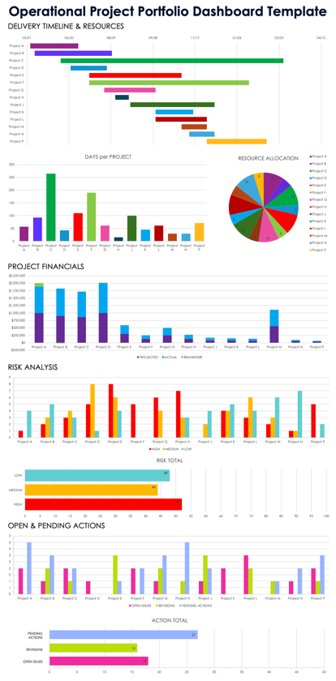
PowerPoint Project Portfolio Template
To create the charts and graphs for this presentation, use the Smartsheet Operational Project Portfolio Dashboard Template in Excel or Google Sheets format to enter your project portfolio data. Capture screenshots of the populated charts and incorporate the images into the corresponding slides.

Slide 2

Project Portfolio Dashboard
Company Name
123 Avenue A
City, State 10001
000-000-0000
web address
Prepared By
Date
Preparer Name
00/00/0000

Slide 3



Project Portfolio Dashboard
Delivery Timeline
Days Per Project
Resource Allocation
Project Financials
Risk Analysis
Open & Pending Actions

Slide 4
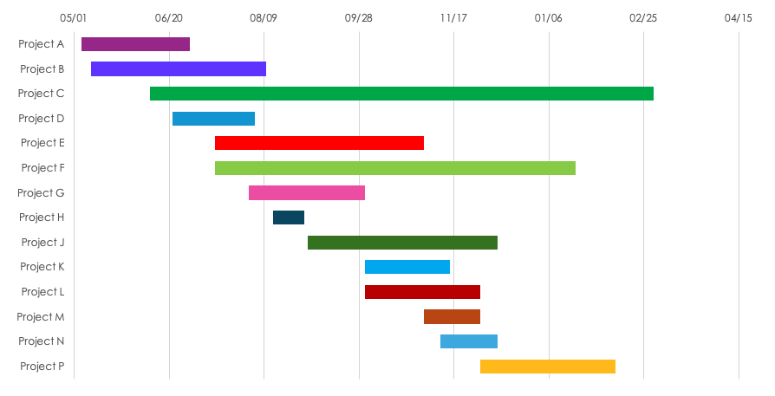
Delivery Timeline

Slide 5
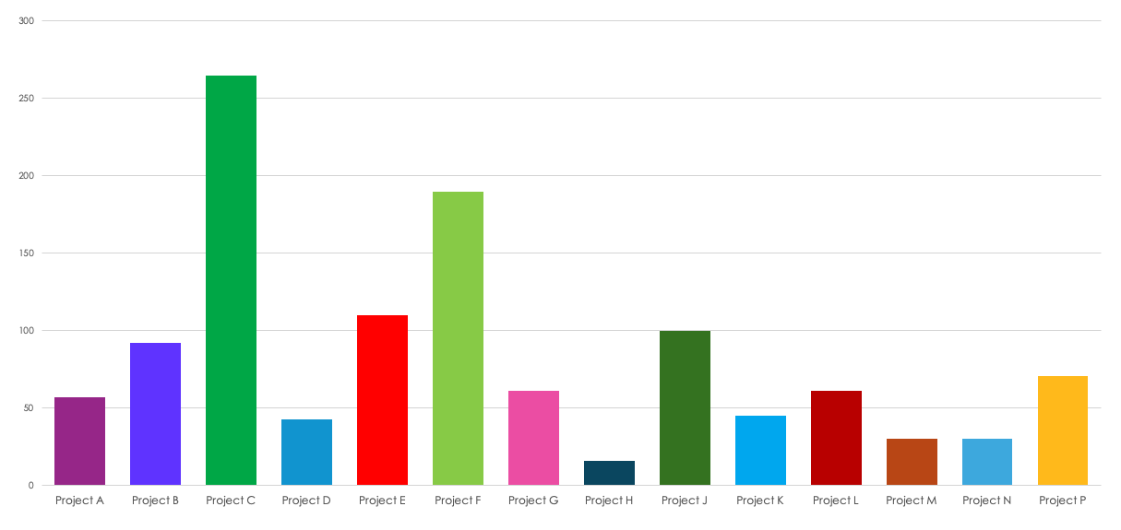
Days Per Project

Slide 6
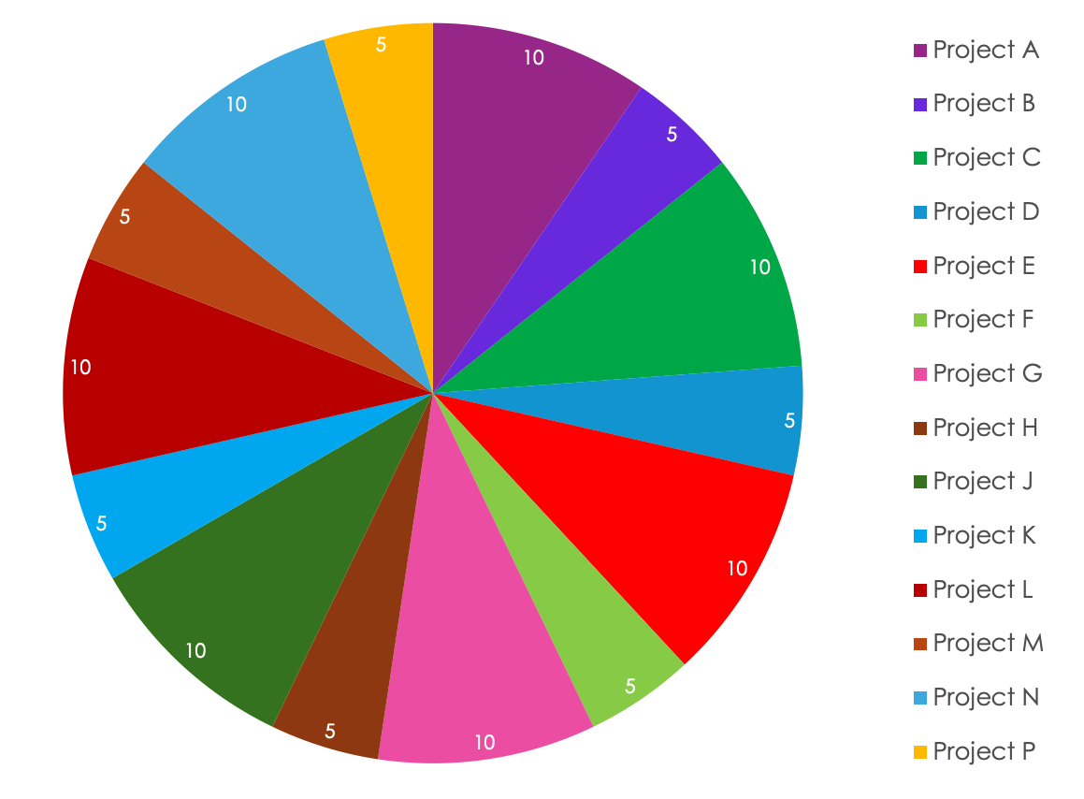
Resource Allocation
Number of Team Members per Project

Slide 7
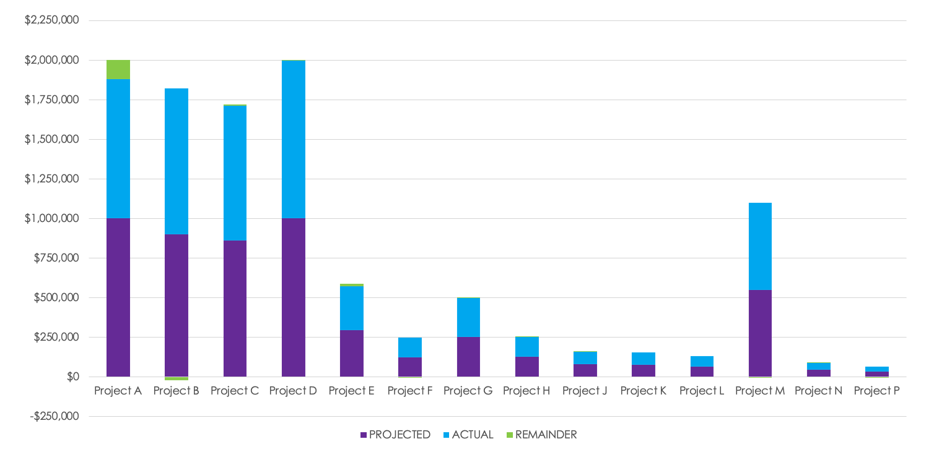
Project Financials

Slide 8
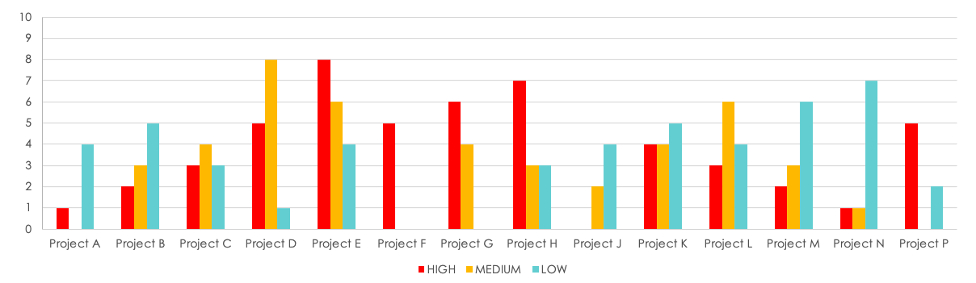
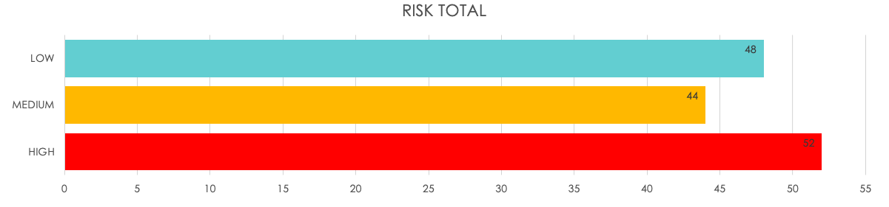
Risk Analysis

Slide 9
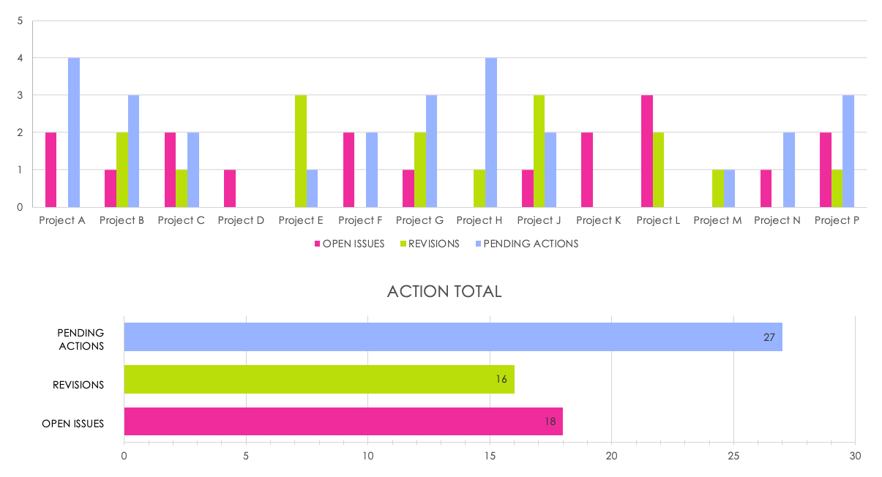
Open & Pending Actions

Slide 10
DISCLAIMER Any articles, templates, or information provided by Smartsheet on the website are for reference only. While we strive to keep the information up to date and correct, we make no representations or warranties of any kind, express or implied, about the completeness, accuracy, reliability, suitability, or availability with respect to the website or the information, articles, templates, or related graphics contained on the website. Any reliance you place on such information is therefore strictly at your own risk.

