Slide 1
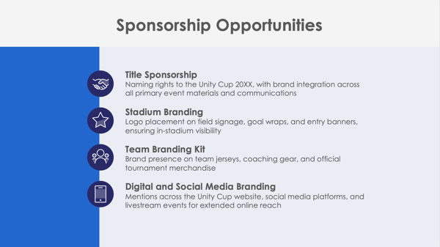
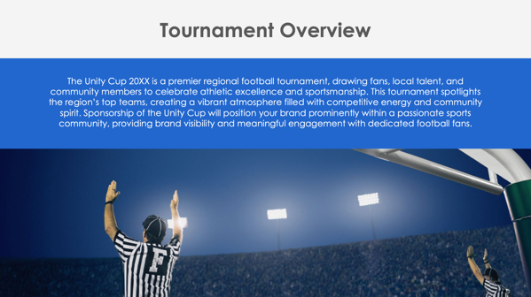
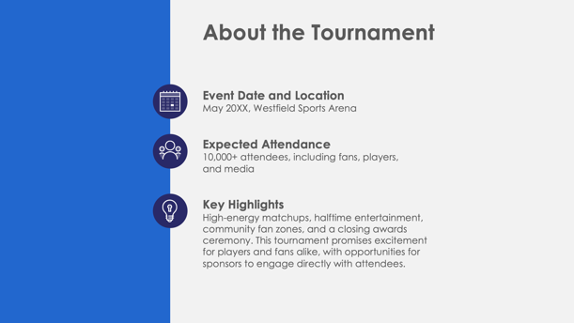
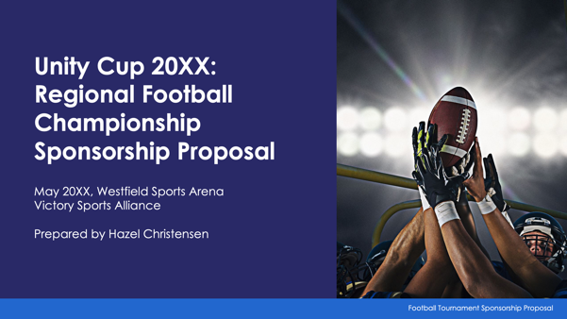
PowerPoint Football Tournament Sponsorship Proposal Template

Slide 2
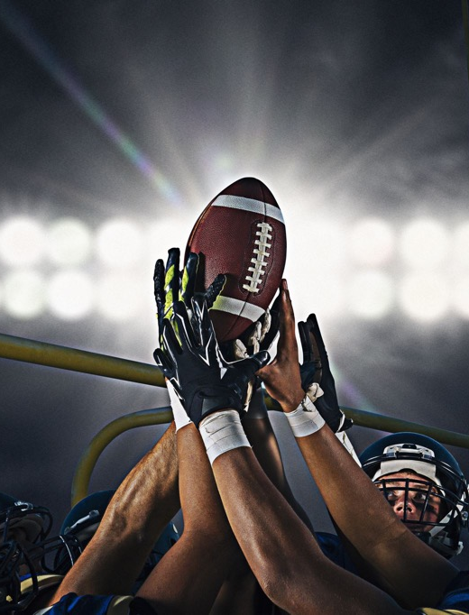
Tournament Name Sponsorship Proposal
Event Date and Location
Organization’s Name
Prepared by Name
Football Tournament Sponsorship Proposal

Slide 3
Contents
1 | Tournament Overview
2 | About the Tournament
3 | Sponsorship Opportunities
4 | Sponsorship Benefits
5 | Sponsorship Packages
6 | Custom Sponsorship Opportunities
7 | Marketing and Promotion Plan
8 | Audience Reach and Fan Demographics
9 | Fan Engagement and Activation Opportunities
10 | Previous Successes and Testimonials
11 | Contact Information

Slide 4
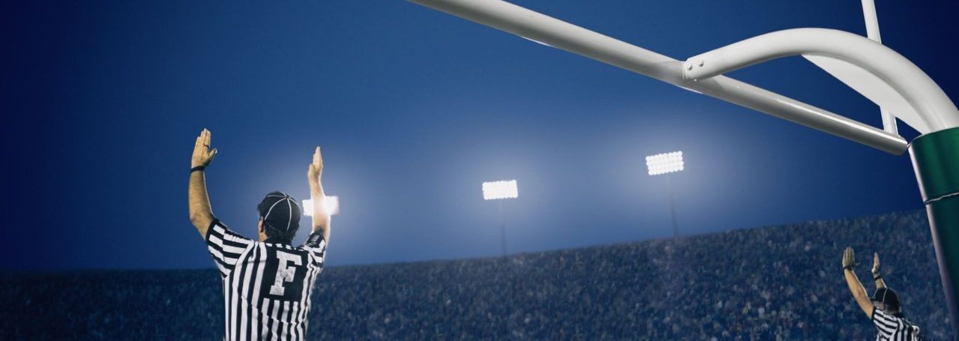
Tournament Overview

Slide 5
About the Tournament
Event Date and Location
Expected Attendance
Key Highlights

Slide 6
Sponsorship Opportunities
Title Sponsorship
Stadium Branding
Team Branding Kit
Digital and Social Media Branding

Slide 7
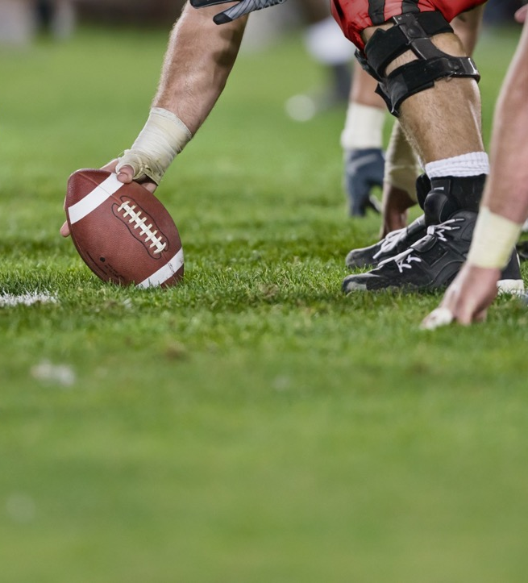
Sponsorship Benefits
4

Slide 8
Sponsorship Packages
Platinum Package
Gold Package
Silver Package
Bronze Package
$X,XXX
$X,XXX
$X,XXX
$X,XXX

Slide 9
Custom Sponsorship Opportunities

Slide 10
Marketing and Promotion Plan
Pre-Tournament
During Tournament
Post-Tournament
7

Slide 11
Audience Reach and Fan Demographics
Attendance and Viewership
Audience Demographics
Media Coverage

Slide 12
Fan Engagement and Activation Opportunities
Fan Zones
Sponsor Booths
Contests and Giveaways
VIP Lounge

Slide 13
Previous Successes and Testimonials
The Tournament Name’s previous events have…
attracted over
XX,XXX attendees
garnered
XX,XXX+ media impressions
Feedback from previous sponsors includes:
“Quote here.”

Slide 14
Contact Information
Sponsorship Coordinator
Name
Website
Email
tournament.org
sponsorships@tournament.org
Phone
Web & Social
(555) 345-6789
Follow us on Instagram, X, Facebook, and Threads for updates on Unity Cup 20XX.

Slide 15
DISCLAIMER Any articles, templates, or information provided by Smartsheet on the website are for reference only. While we strive to keep the information up to date and correct, we make no representations or warranties of any kind, express or implied, about the completeness, accuracy, reliability, suitability, or availability with respect to the website or the information, articles, templates, or related graphics contained on the website. Any reliance you place on such information is therefore strictly at your own risk.

