Slide 1
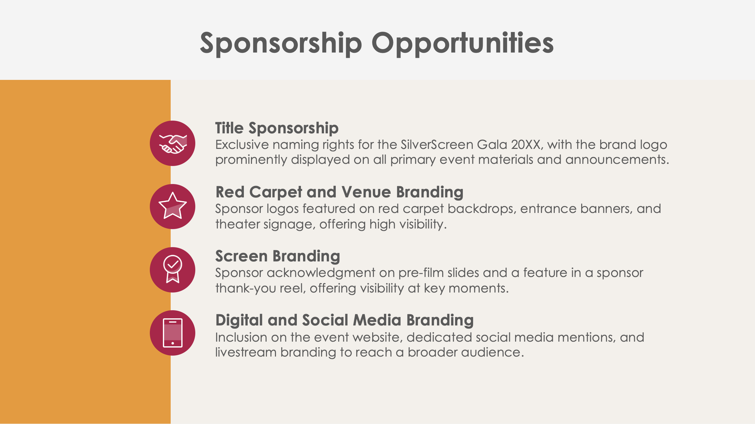
PowerPoint Film Sponsorship Proposal Template Example

Slide 2
SilverScreen Gala 20XX: A Celebration of Independent Film
Sponsorship Proposal
March 20XX, Downtown Theater Plaza
Horizon Cinema Collective
Prepared by Guadalupe Garcia
EXAMPLE: Film Sponsorship Proposal

Slide 3
Contents
1 | Event Overview
2 | About the Event
3 | Sponsorship Opportunities
4 | Sponsorship Benefits
5 | Sponsorship Packages
6 | Custom Sponsorship Opportunities
7 | Marketing and Promotion Plan
8 | Audience Reach and Media Coverage
9 | VIP Fan Engagement Opportunities
10 | Previous Successes and Testimonials
11 | Contact Information

Slide 4
Event Overview
The SilverScreen Gala 20XX is a premiere event celebrating independent film and storytelling. This gala brings filmmakers, critics, and movie enthusiasts together to highlight the creativity and impact of indie cinema. Sponsorship allows brands to connect with a cultured audience and showcase their support for the arts, aligning with the prestige of the film industry.

Slide 5
About the Event
Event Date and Location
March 20XX, Downtown Theater Plaza
Expected Attendance
800+ attendees, including filmmakers, media, and film enthusiasts
Key Highlights
A red carpet, director Q&As, industry networking events, and exclusive film screenings set the stage for a memorable event.

Slide 6
Sponsorship Opportunities
Title Sponsorship
Exclusive naming rights for the SilverScreen Gala 20XX, with the brand logo prominently displayed on all primary event materials and announcements.
Red Carpet and Venue Branding
Sponsor logos featured on red carpet backdrops, entrance banners, and theater signage, offering high visibility.
Screen Branding
Sponsor acknowledgment on pre-film slides and a feature in a sponsor thank-you reel, offering visibility at key moments.
Digital and Social Media Branding
Inclusion on the event website, dedicated social media mentions, and livestream branding to reach a broader audience.

Slide 7
Sponsorship Benefits
Sponsors gain premium visibility at the SilverScreen Gala 20XX with multiple brand placements, both on-site and in digital promotions. The event connects brands with influential film audiences, reinforcing a sponsor’s commitment to supporting the arts. Aligning with this event enhances the sponsor’s prestige and showcases dedication to creativity and culture.
4

Slide 8
Sponsorship Packages
Platinum Package
Title sponsorship with brand logo placement on all red-carpet backdrops, 20 VIP tickets, exclusive brand feature in press releases and social media campaigns, and logo on pre-film screens
Gold Package
Prominent brand logo placement on selected theater signage, 15 VIP tickets, access to a branded VIP welcome area, and mentions in event emails
Silver Package
Brand logo placement on the event website and printed programs, 10 general admission tickets, and acknowledgment in post-event summary materials
Bronze Package
Logo placement in the event program, social media acknowledgment, and five general admission tickets
$X,XXX
$X,XXX
$X,XXX
$X,XXX

Slide 9
Custom Sponsorship Opportunities
SilverScreen Gala 20XX offers personalized opportunities such as branded gift bags, sponsor-hosted Q&A sessions with directors, branded VIP lounges, and sponsor-named awards. These custom options allow for a distinct brand presence that resonates with filmgoers and industry influencers.

Slide 10
Marketing and Promotion Plan
Pre-Event
The sponsor is featured in social media announcements, digital advertising campaigns, and press releases that reach film industry professionals and audiences.
During Event
Real-time social media updates, sponsor mentions on digital screens, and branded livestreams provide continuous brand exposure.
Post-Event
A recap video, thank-you posts featuring sponsor logos, and follow-up emails with event highlights will extend sponsor visibility.
7

Slide 11
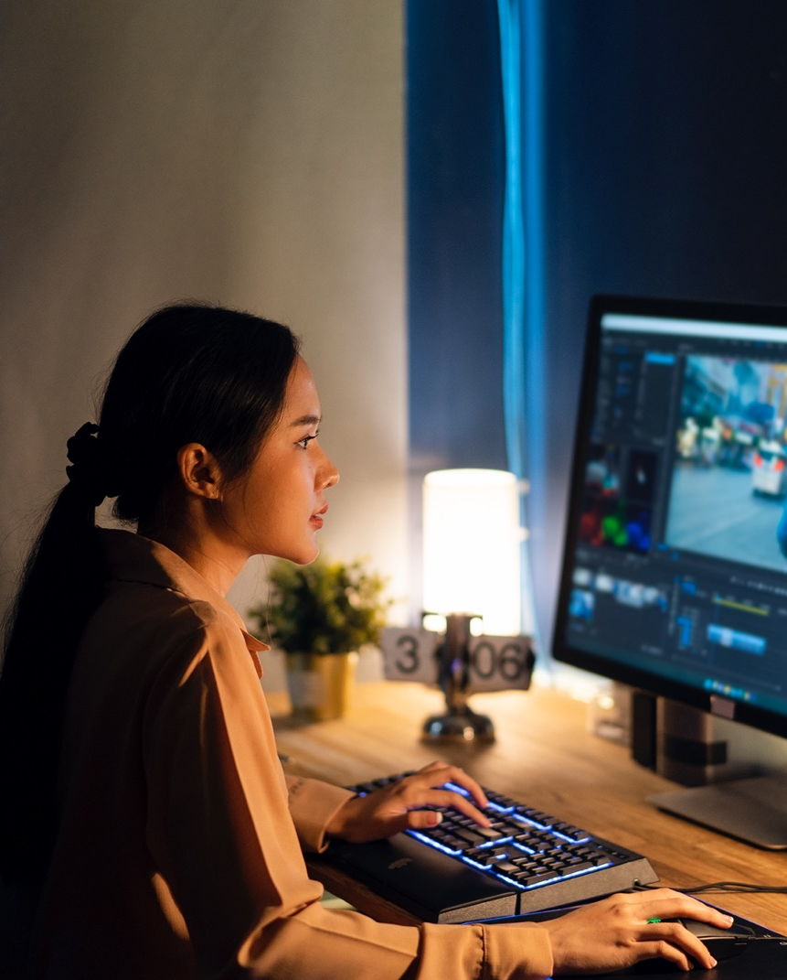
Audience Reach and Media Coverage
Attendance
Over 800 in-person attendees, with a livestream projected to reach thousands more online
Demographics
Film enthusiasts, industry professionals, and cultural influencers aged 25–55 interested in the arts and media
Media Exposure
Coverage expected in local film publications, entertainment websites, and social media influencers, ensuring broad visibility for sponsors

Slide 12
VIP Fan Engagement Opportunities
VIP Lounge Branding
Sponsors will have exclusive branding rights to VIP lounge areas, creating a premium brand presence.
Meet-and-Greet Sessions
Sponsors can host intimate meet-and-greet sessions with film directors or cast members, providing memorable experiences for guests.
Photo Booths and Social Media Stations
Sponsor-branded areas for guest photos can be shared on social media, enhancing online engagement.
Interactive Social Media Campaigns
Sponsors will gain high visibility through event-focused social media challenges and interactive content before, during, and after the event.

Slide 13
Previous Successes and Testimonials
Last year’s SilverScreen Gala…
attracted over
800 attendees
garnered
40,000+ media impressions
Feedback from previous sponsors includes:
“The SilverScreen Gala provided exceptional exposure to a cultured audience, aligning our brand with the arts and enhancing our image within the film community.”
These metrics and testimonials highlight the event’s impact and sponsor value.

Slide 14
Contact Information
Sponsorship Coordinator
Henry McNeal
Website
Email
horizoncinemacollective.com
sponsorships@horizoncinemacollective.com
Phone
Web & Social
(555) 789-1234
Follow us on LinkedIn, Facebook, Threads, and X for event updates.

Slide 15
DISCLAIMER Any articles, templates, or information provided by Smartsheet on the website are for reference only. While we strive to keep the information up to date and correct, we make no representations or warranties of any kind, express or implied, about the completeness, accuracy, reliability, suitability, or availability with respect to the website or the information, articles, templates, or related graphics contained on the website. Any reliance you place on such information is therefore strictly at your own risk.

