Slide 1
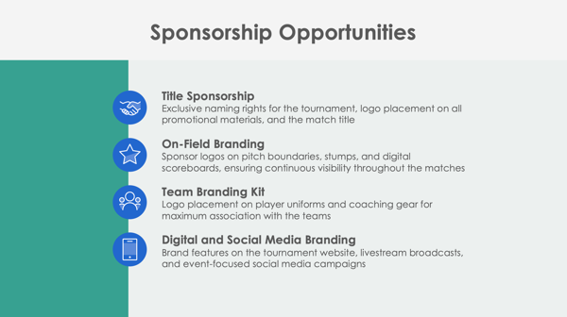
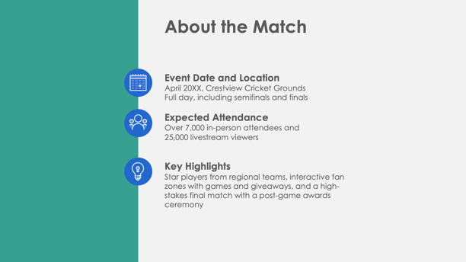
PowerPoint Cricket Sponsorship Proposal Template

Slide 2
Tournament Name Sponsorship Proposal
Event Date and Location
Organization’s Name
Prepared by Name
Cricket Sponsorship Proposal

Slide 3
Contents
1 | Match Overview
2 | About the Match
3 | Sponsorship Opportunities
4 | Sponsorship Benefits
5 | Sponsorship Packages
6 | Custom Sponsorship Opportunities
7 | Marketing and Promotion Plan
8 | Audience Reach and Media Coverage
9 | Fan Engagement and Activation Opportunities
10 | Previous Successes and Testimonials
11 | Contact Information

Slide 4
Match Overview

Slide 5
About the Match
Event Date and Location
Expected Attendance
Key Highlights

Slide 6
Sponsorship Opportunities
Title Sponsorship
On-Field Branding
Team Branding Kit
Digital and Social Media Branding

Slide 7
Sponsorship Benefits
4

Slide 8
Sponsorship Packages
Platinum Package
Gold Package
Silver Package
Bronze Package
$X,XXX
$X,XXX
$X,XXX
$X,XXX

Slide 9
Custom Sponsorship Opportunities

Slide 10
Marketing and Promotion Plan
Pre-Match
During Match
Post-Match
7

Slide 11
Audience Reach and Fan Demographics
Projected Reach
Projected on-site attendance, broadcast, and streaming viewership
Audience Demographics
Key audience demographics like age, interests, and location distribution
Media Coverage
Media partners like sports channels and online streaming platforms

Slide 12
Fan Engagement and Activation Opportunities
Fan Zones
Meet-and-Greets
Contests and Giveaways
VIP Lounge

Slide 13
Previous Successes and Testimonials
The 20XX Match Name had…
over
X,XXX attendees
over
XX,XXX livestream views
Feedback from previous sponsors includes:
“Quote here.”

Slide 14
Contact Information
Sponsorship Coordinator
Name
Website
Email
company.com
sponsorships@company.com
Phone
Web & Social
(555) 678-4321
Follow us on Instagram, X, Facebook, and Threads for updates on Unity Cup 20XX.

Slide 15
DISCLAIMER Any articles, templates, or information provided by Smartsheet on the website are for reference only. While we strive to keep the information up to date and correct, we make no representations or warranties of any kind, express or implied, about the completeness, accuracy, reliability, suitability, or availability with respect to the website or the information, articles, templates, or related graphics contained on the website. Any reliance you place on such information is therefore strictly at your own risk.

