Slide 1


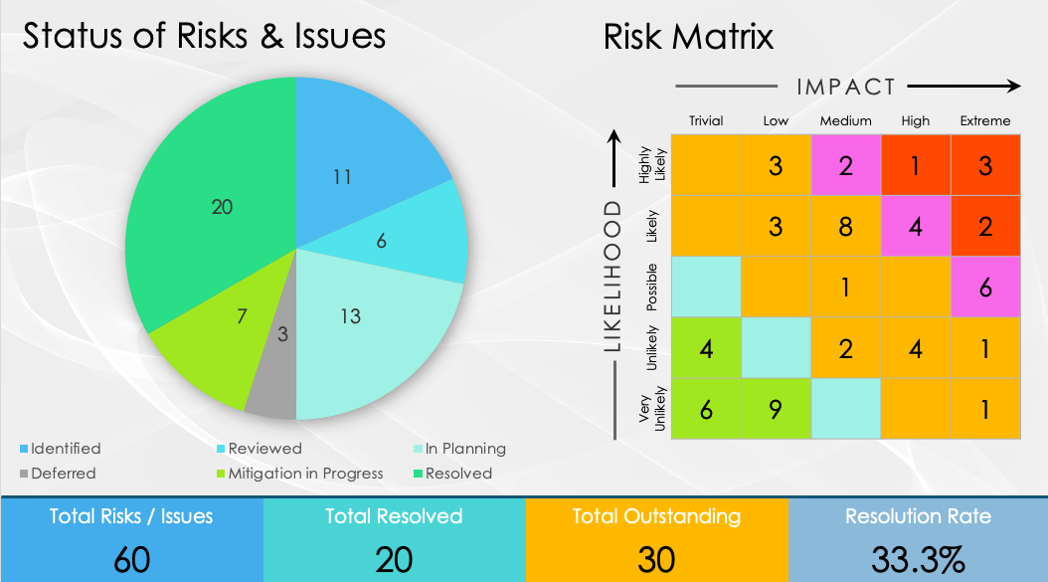
PowerPoint Risk Management Project Portfolio Dashboard Template

Slide 2
Status of Risks & Issues
Risk Matrix
IMPACT
 | Trivial | Low | Medium | High | Extreme
Highly Likely |  | 3 | 2 | 1 | 3
Likely |  | 3 | 8 | 4 | 2
Possible |  |  | 1 |  | 6
Unlikely | 4 |  | 2 | 4 | 1
Very Unlikely | 6 | 9 |  |  | 1
LIKELIHOOD
Total Risks / Issues
60
Total Resolved
20
Total Outstanding
30
Resolution Rate
33.3%

Slide 3
DISCLAIMER Any articles, templates, or information provided by Smartsheet on the website are for reference only. While we strive to keep the information up to date and correct, we make no representations or warranties of any kind, express or implied, about the completeness, accuracy, reliability, suitability, or availability with respect to the website or the information, articles, templates, or related graphics contained on the website. Any reliance you place on such information is therefore strictly at your own risk.

