Slide 1
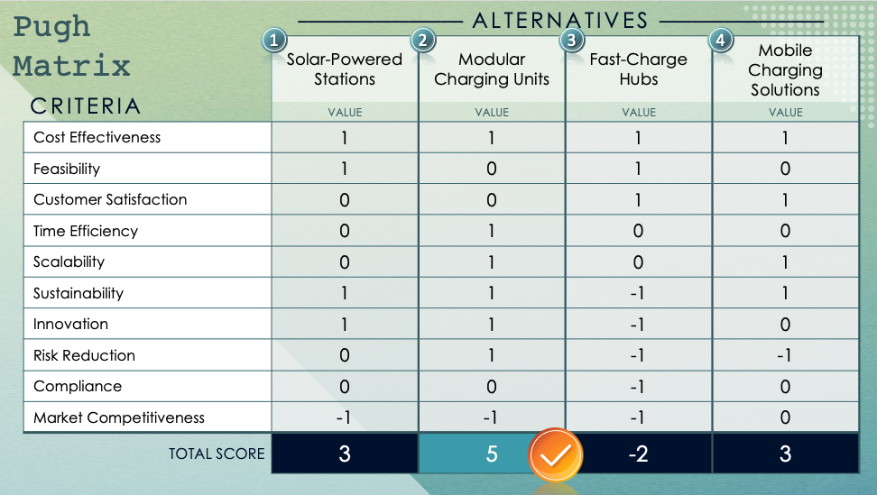
Unweighted Pugh Matrix Template

Slide 2
Criteria
Criteria are the key factors or standards used to evaluate and compare different alternatives. Each criterion helps assess how well an alternative meets specific goals or requirements.
Alternatives
Alternatives are different solutions or approaches that can be customized and compared against the criteria.
Values
Points are assigned to each alternative for each criterion (e.g., 1 for better, 0 for equal, -1 for worse) to indicate how well the alternative meets the criterion.
Total
The total score for each alternative is calculated by summing the values across all criteria, helping to identify the best option.

Slide 3
Pugh Matrix
––––––––––––––– Alternatives –––––––––––––––
1
2
3
4
Criteria | One | Two | Three | Four
 | Value | Value | Value | Value
Cost Effectiveness
Feasibility
Customer Satisfaction
Time Efficiency
Scalability
Sustainability
Innovation
Risk Reduction
Compliance
Market Competitiveness
Total Score

Slide 4
Pugh Matrix
––––––––––––––– Alternatives –––––––––––––––
1
2
3
4
Criteria | One | Two | Three | Four
 | Value | Value | Value | Value
Factor One
Total Score

Slide 5
Conclusion
Conclusion text

Slide 6
DISCLAIMER Any articles, templates, or information provided by Smartsheet on the website are for reference only. While we strive to keep the information up to date and correct, we make no representations or warranties of any kind, express or implied, about the completeness, accuracy, reliability, suitability, or availability with respect to the website or the information, articles, templates, or related graphics contained on the website. Any reliance you place on such information is therefore strictly at your own risk.

