Slide 1



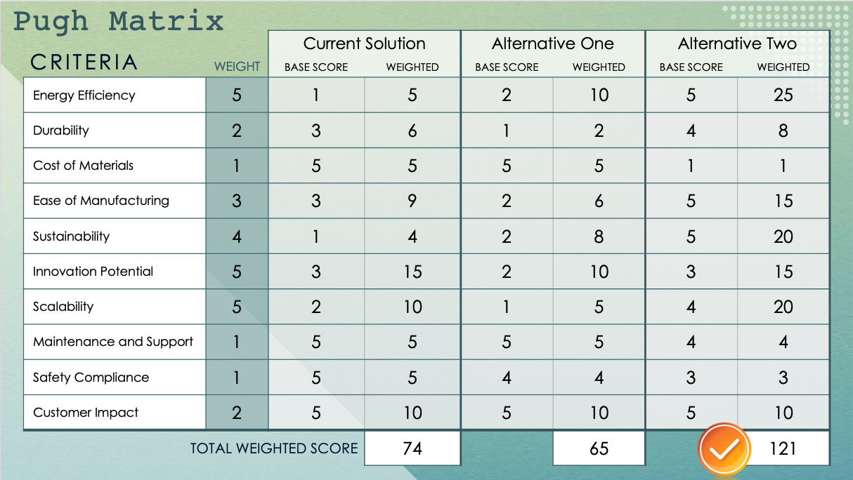
Engineering Pugh Matrix Template – Example

Slide 2
Pugh Matrix
CRITERIA |  | Current Solution |  | Alternative One |  | Alternative Two
 | WEIGHT | BASE SCORE | WEIGHTED | BASE SCORE | WEIGHTED | BASE SCORE | WEIGHTED
Energy Efficiency | 5 | 1 | 5 | 2 | 10 | 5 | 25
Durability | 2 | 3 | 6 | 1 | 2 | 4 | 8
Cost of Materials | 1 | 5 | 5 | 5 | 5 | 1 | 1
Ease of Manufacturing | 3 | 3 | 9 | 2 | 6 | 5 | 15
Sustainability | 4 | 1 | 4 | 2 | 8 | 5 | 20
Innovation Potential | 5 | 3 | 15 | 2 | 10 | 3 | 15
Scalability | 5 | 2 | 10 | 1 | 5 | 4 | 20
Maintenance and Support | 1 | 5 | 5 | 5 | 5 | 4 | 4
Safety Compliance | 1 | 5 | 5 | 4 | 4 | 3 | 3
Customer Impact | 2 | 5 | 10 | 5 | 10 | 5 | 10
TOTAL WEIGHTED SCORE |  |  | 74 |  | 65 |  | 121

Slide 3
Pugh Matrix
CRITERIA |  | Current Solution |  | Alternative One |  | Alternative Two
 | WEIGHT | BASE SCORE | WEIGHTED | BASE SCORE | WEIGHTED | BASE SCORE | WEIGHTED
Factor 1
TOTAL WEIGHTED SCORE

Slide 4
Pugh Matrix
CRITERIA |  | Current Solution |  | Alternative One |  | Alternative Two
 | WEIGHT | BASE SCORE | WEIGHTED | BASE SCORE | WEIGHTED | BASE SCORE | WEIGHTED
Factor 1
TOTAL WEIGHTED SCORE

Slide 5

Conclusion
Conclusion text

Slide 6
DISCLAIMER Any articles, templates, or information provided by Smartsheet on the website are for reference only. While we strive to keep the information up to date and correct, we make no representations or warranties of any kind, express or implied, about the completeness, accuracy, reliability, suitability, or availability with respect to the website or the information, articles, templates, or related graphics contained on the website. Any reliance you place on such information is therefore strictly at your own risk.

