Slide 1
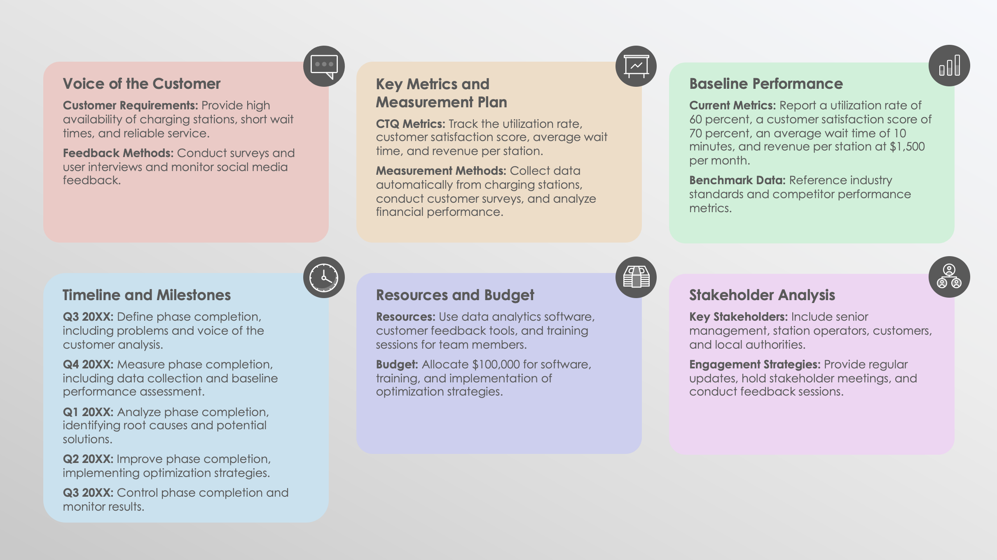
PowerPoint Six Sigma Charter Template
FPO

Slide 2
PowerPoint Six Sigma Charter
Project Title:
Team Name: |  | Date: | July 8, 20XX
Business Case
Explanation: Explain the project's importance.
Alignment: Align the project with organizational goals and strategic priorities.
Problem Statement
Description: Include a detailed description of the problem.
Impact: Explain the problem’s impact on the organization (financial, operational, etc.).
Project Objective
SMART Goals: Ensure your project objective is specific, measurable, achievable, relevant, and time-bound.
Project Scope
Included: List the tasks and deliverables that are within the scope of the project
Out of Scope: List the tasks and deliverables that are out of scope to prevent scope creep.
Team Composition and Roles
Team Leader: Include their name, role description, and responsibilities.
Team Members: Include their name, role description, and responsibilities.
Contact Information: Provide for all team members.

Slide 3
Voice of the Customer
Customer Requirements: Identify the customer requirements and expectations.
Feedback Methods: Specify the feedback collection methods (surveys, interviews, etc.).
Key Metrics and Measurement Plan
CTQ Metrics: Include all critical-to-quality (CTQ) metrics.
Measurement Methods: List key performance indicators (KPIs), measurement methods, and data collection plans.
Baseline Performance
Current Metrics: Include the current performance metrics.
Benchmark Data: Identify benchmark data.
Timeline and Milestones
Create a project timeline with key milestones and phase completions. The DMAIC phases are Define, Measure, Analyze, Improve, and Control.
Q1 20XX: Milestone.
Q2 20XX: Milestone.
Q3 20XX: Milestone.
Q4 20XX: Phase Completion.
Resources and Budget
Resources: Allocate resources (personnel, tools, technology).
Budget: Allocate budget and financial resources.
Stakeholder Analysis
Key Stakeholders: Identify key stakeholders and their interests and influence.
Engagement Strategies: Develop engagement and communication strategies.

Slide 4
Risk Management
Potential Risks: Identify any potential risks and their impact.
Mitigation Strategies: Develop mitigation strategies and a risk monitoring plan.
Communication Plan
Internal: Detail your internal communication hierarchy and flow and methods for sharing information (meetings, reports, dashboards).
External: Detail your external communication hierarchy and flow and methods for sharing information (meetings, reports, dashboards).
Decision-Making Process
Framework: Select a decision-making framework.
Conflict Resolution: Select conflict resolution methods.
Final Authority: Assign final authority for decisions.
Training and Development Plan
Training Requirements: List training requirements for team members.
Schedule: Outline your schedule for Six Sigma training sessions (Black Belt, Green Belt, etc.).
Change Management Plan
Procedures: List your procedures for managing changes to scope, resources, or timeline, and you documentation and approval process for changes.
Approval and Sign-off
Approval Signatures:
Acquire signatures from key stakeholders for formal approval of the project charter and its terms.
Name Title
Date: July 8, 20XX

Slide 5
EXAMPLE: PowerPoint Six Sigma Charter
Project Title: | Optimizing EV Charging Station Utilization
Team Name: | Positive Charge Excellence Team | Date: | July 8, 20XX
Business Case
Explanation: With the rapid growth in the EV market, optimizing the utilization of our charging stations is crucial to meeting customer demand and maximizing ROI.
Alignment: This project aligns with Positive Charge's strategic goal of becoming the leading provider of EV charging solutions by improving operational efficiency and customer satisfaction.
Problem Statement
Description: Our current utilization rate of EV charging stations is below 60 percent, resulting in lost revenue and underperformance in key markets.
Impact: The low utilization rate is costing the company approximately $500,000 annually in potential revenue and reducing customer satisfaction.
Project Objective
SMART Goals: Increase the utilization rate of EV charging stations to 85 percent within the next 12 months, thereby increasing revenue by $300,000 annually and improving customer satisfaction scores by 20 percent.
Project Scope
Included: Analyze charging station usage data, identify underperforming stations, develop optimization strategies, implement enhancements, and monitor results.
Out of Scope: Expand the charging network and hardware upgrades beyond the identified optimization strategies.
Team Composition and Roles
Team Leader (Black Belt): Brooklyn Jansen oversees project execution and ensures alignment with Six Sigma principles.
Green Belt: Leigh Gibbs leads data analysis and identification of optimization opportunities.
Yellow Belt: Devon Gomez manages stakeholder communication and voice of the customer analysis.
Subject Matter Expert: Raghu Prakash provides insights on EV market trends and customer behavior.
IT Support: Tamika Marshall assists with data integration and technology implementation.

Slide 6
Voice of the Customer
Customer Requirements: Provide high availability of charging stations, short wait times, and reliable service.
Feedback Methods: Conduct surveys and user interviews and monitor social media feedback.
Key Metrics and Measurement Plan
CTQ Metrics: Track the utilization rate, customer satisfaction score, average wait time, and revenue per station.
Measurement Methods: Collect data automatically from charging stations, conduct customer surveys, and analyze financial performance.
Baseline Performance
Current Metrics: Report a utilization rate of 60 percent, a customer satisfaction score of 70 percent, an average wait time of 10 minutes, and revenue per station at $1,500 per month.
Benchmark Data: Reference industry standards and competitor performance metrics.
Timeline and Milestones
Q3 20XX: Define phase completion, including problems and voice of the customer analysis.
Q4 20XX: Measure phase completion, including data collection and baseline performance assessment.
Q1 20XX: Analyze phase completion, identifying root causes and potential solutions.
Q2 20XX: Improve phase completion, implementing optimization strategies.
Q3 20XX: Control phase completion and monitor results.
Resources and Budget
Resources: Use data analytics software, customer feedback tools, and training sessions for team members.
Budget: Allocate $100,000 for software, training, and implementation of optimization strategies.
Stakeholder Analysis
Key Stakeholders: Include senior management, station operators, customers, and local authorities.
Engagement Strategies: Provide regular updates, hold stakeholder meetings, and conduct feedback sessions.

Slide 7
Risk Management
Potential Risks: Address data inaccuracies, resistance to change, and budget overruns.
Mitigation Strategies: Implement rigorous data validation, provide change management training, and conduct regular budget reviews.
Communication Plan
Internal: Conduct weekly team meetings, generate bi-weekly progress reports, and provide real-time updates via project management tools.
External: Share monthly updates with stakeholders, issue press releases for major milestones, and make announcements on social media.
Decision-Making Process
Framework: Make decisions collaboratively during team meetings; major decisions require approval from the Black Belt and key stakeholders.
Conflict Resolution: Facilitate mediation by a neutral team member.
Final Authority: Designate Project Leader, Brooklyn Jansen, as the final authority.
Training and Development Plan
Training Requirements: Schedule Six Sigma training sessions for team members (Black Belt, Green Belt, etc.).
Schedule: Begin initial training in Q3 20XX and continue development throughout the project.
Change Management Plan
Procedures: All change requests must be submitted in writing. The project leader reviews and approves changes, ensuring documentation and alignment with project goals.
Approval and Sign-off
Approval Signatures:
Brooklyn Jansen Project Leader (Black Belt)
Leigh Gibbs Data Analyst (Green Belt)
Devon Gomez Stakeholder Manager (Yellow Belt)
Date: July 8, 20XX

Slide 8
DISCLAIMER Any articles, templates, or information provided by Smartsheet on the website are for reference only. While we strive to keep the information up to date and correct, we make no representations or warranties of any kind, express or implied, about the completeness, accuracy, reliability, suitability, or availability with respect to the website or the information, articles, templates, or related graphics contained on the website. Any reliance you place on such information is therefore strictly at your own risk.

