Slide 1


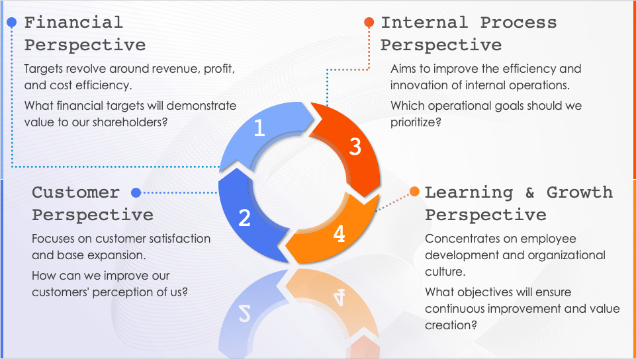
Balanced Scorecard
4 Perspectives Template
When to Use This Template: This template allows you to define and illustrate the four perspectives of a balanced scorecard. Use this tool to guide teams through the components of strategic management and performance measurement. Everyone in your strategy meetings, training sessions, and progress assessments can benefit from this clear layout, which helps individuals understand how their roles align with the broader organizational strategy.
Notable Template Features: The template visually separates the four core areas of a balanced scorecard using distinct colors and icons around a central point that signifies the integration of all perspectives. You can add a guiding question or explanatory text for each perspective to foster a deeper understanding of each domain’s impact on overall strategy. This setup encourages comprehensive discussion concerning how different parts of the organization contribute to its success.

Slide 2
Financial Perspective
Internal Process Perspective
Targets revolve around revenue, profit, and cost efficiency.
What financial targets will demonstrate value to our shareholders?
Aims to improve the efficiency and innovation of internal operations.
Which operational goals should we prioritize?
1
1
3
3
Customer Perspective
Learning & Growth Perspective
2
2
4
4
Focuses on customer satisfaction and base expansion.
How can we improve our customers' perception of us?
Concentrates on employee development and organizational culture.
What objectives will ensure continuous improvement and value creation?

Slide 3
DISCLAIMER Any articles, templates, or information provided by Smartsheet on the website are for reference only. While we strive to keep the information up to date and correct, we make no representations or warranties of any kind, express or implied, about the completeness, accuracy, reliability, suitability, or availability with respect to the website or the information, articles, templates, or related graphics contained on the website. Any reliance you place on such information is therefore strictly at your own risk.

