Slide 1


3-Year Strategic Plan Template

Slide 2


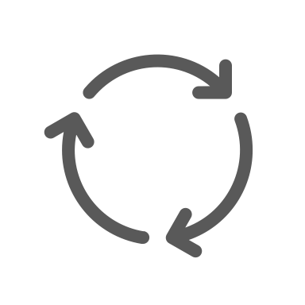
HOW TO USE THIS TEMPLATE
Start with a Vision
At the top of the slide, clearly state your overarching vision for the three-year period. This sets the direction for all strategic efforts.
Include Milestones
For each year, mark key milestones directly on the timeline. This visual cue helps track progress toward larger goals.
1
5
Due MM/DD
Due MM/DD
Due MM/DD
2
Segment the Slide
Divide your slide into three sections, one for each year. Label each section with the year and the corresponding focus (Foundation Setting, Growth and Adaptation, Consolidation and Innovation).
6
Use Icons
Incorporate simple icons to represent each main component (e.g., a clock for Ensure Timeliness, a magnifying glass for Review and Adjust). Icons can make the slide more engaging and easier to scan.
3
Fill in the Details
Under each year, list the main components as bullet points. Use concise language to keep the slide readable.
7
Add Notes
Use PowerPoint’s Notes section to provide additional context that might be too detailed for the main slide.
4
Assign Colors
Create a color code for different types of activities (e.g., blue for Define Roles or green for Develop Action Plan). Use this color scheme consistently across all three sections to help viewers quickly understand the type of activities planned.
8
Review and Revise
Regularly review your strategic plan slide with your team. Update it as strategies evolve or as new opportunities and challenges arise.

Slide 3






SAMPLE 3-YEAR STRATEGIC PLAN
20XX – Foundation Setting
20XX – Growth & Adaptation
20XX – Consolidation & Innovation
DEFINE ROLES
REVIEW AND ADJUST
CONSOLIDATE GAINS
Clearly assign strategic roles and responsibilities to team members.
Evaluate outcomes and adjust strategies accordingly.
Focus on solidifying the progress made and ensuring sustainable growth.
Due MM/DD
DEVELOP ACTION PLAN
EXPAND INITIATIVES
INNOVATE PROCESSES
Outline specific actions to kickstart your strategic objectives.
Scale successful strategies and explore new opportunities for growth.
Implement innovative practices to enhance efficiency and effectiveness.
Due MM/DD
ENSURE TIMELINESS
STRENGTHEN
ENGAGEMENT
PREPARE FOR
NEXT CYCLE
Establish clear timelines for each action to maintain momentum.
Increase stakeholder involvement through regular updates and feedback.
Begin laying the groundwork for the next strategic planning cycle.

Slide 4
3-YEAR STRATEGIC PLAN
20XX – Focus
20XX – Focus
20XX – Focus
ACTIVITY
ACTIVITY
ACTIVITY
Description
Description
Description
ACTIVITY
ACTIVITY
ACTIVITY
Description
Description
Description
ACTIVITY
ACTIVITY
ACTIVITY
Description
Description
Description

Slide 5
DISCLAIMER Any articles, templates, or information provided by Smartsheet on the website are for reference only. While we strive to keep the information up to date and correct, we make no representations or warranties of any kind, express or implied, about the completeness, accuracy, reliability, suitability, or availability with respect to the website or the information, articles, templates, or related graphics contained on the website. Any reliance you place on such information is therefore strictly at your own risk.

