Slide 1
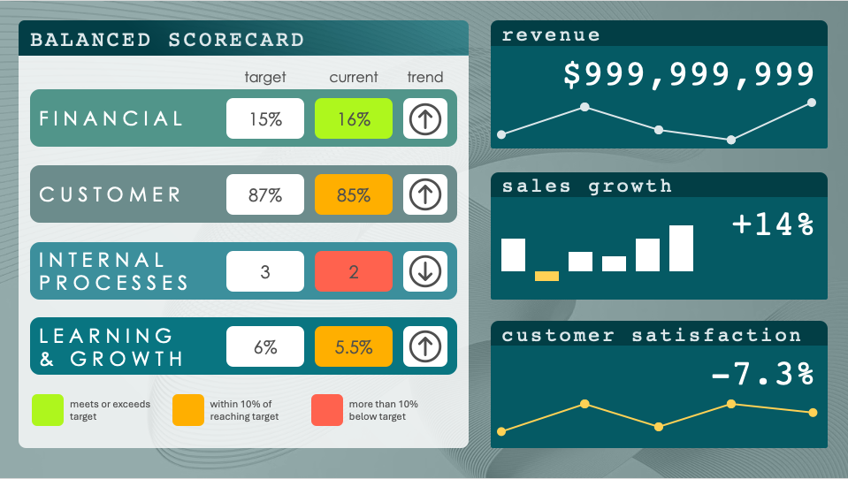
PowerPoint Balanced Scorecard Dashboard Template
When to Use This Template: This dashboard template is designed for executives and managers who need a quick view of company performance. Use the template for board presentations, monthly executive meetings, and daily operational reviews to monitor progress and identify areas needing attention or improvement.
Notable Template Features: The template organizes performance data into a balanced scorecard format with fields for targets, current status, and trend, allowing leaders to assess performance at a glance. The dashboard uses color-coding to signal status, with trend indicators providing insight into whether metrics are improving or declining. This visual approach makes it easy to assess the overall health of the organization.

Slide 2
BALANCED SCORECARD
revenue
$999,999,999
target
current
trend
FINANCIAL
xx
xx
CUSTOMER
sales growth
xx
xx
+14%
INTERNAL PROCESSES
xx
xx
LEARNING
& GROWTH
customer satisfaction
xx
xx
-7.3%
meets or exceeds target
within 10% of reaching target
more than 10% below target

Slide 3
BALANCED SCORECARD
revenue
$999,999,999
target
current
trend
FINANCIAL
15%
16%
CUSTOMER
sales growth
87%
85%
+14%
INTERNAL PROCESSES
3
2
LEARNING
& GROWTH
customer satisfaction
6%
5.5%
-7.3%
meets or exceeds target
within 10% of reaching target
more than 10% below target

Slide 4
DISCLAIMER Any articles, templates, or information provided by Smartsheet on the website are for reference only. While we strive to keep the information up to date and correct, we make no representations or warranties of any kind, express or implied, about the completeness, accuracy, reliability, suitability, or availability with respect to the website or the information, articles, templates, or related graphics contained on the website. Any reliance you place on such information is therefore strictly at your own risk.

